Slide 1
Distributed Knowledge Graph Querying on Edge and Cloud
DS 256 – Project Final Presentation
Shriram R
06-May-19

Slide 2
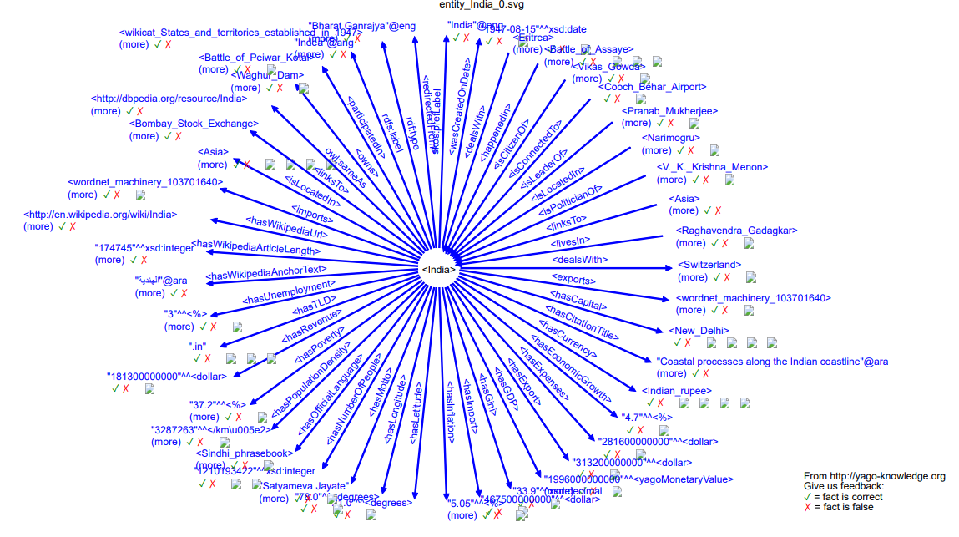
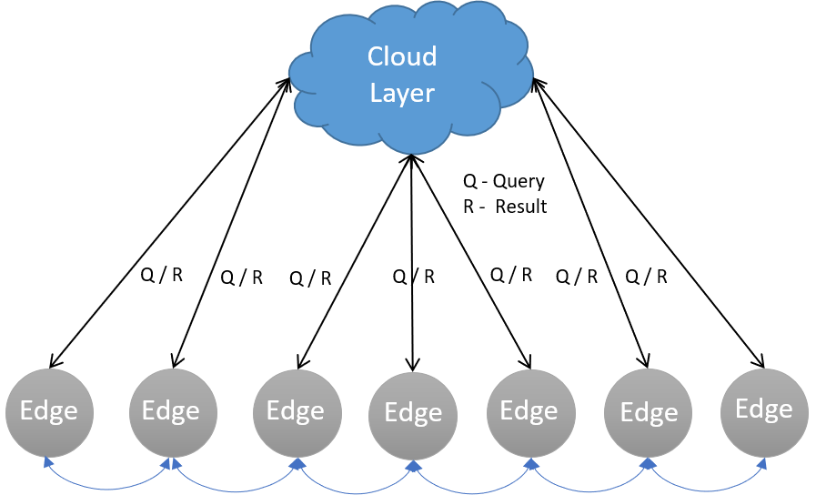
Motivation
Knowledge Graphs are large
Graph querying problems are hard
IoT – Heterogenous Structure
Different Compute, Storage & Network Capacity
Needs lightweight and low latency solution

Slide 3
Related Work
Graph Processing
Pregel [2]
Giraph [3]
GraphX [4]
Trinity [5]
Quegel [13]
Graph Caching
GC [6]
Graph Databases
GoDB [11]
TinkerGraph
Neo4j
Dgraph
Titan
Graph Indexing
C-Tree [7]
Views [8]
FERRARI [9]
GraphS [10]

Slide 4
Key Contributions
Graph Caching
Cache Knowledge graph in Edge layer
Query Partitioning
Partition input graph query into local and remote
Result Generation
Combine results from local and remote server into a correct result
Different Query Types
Vertex, Edge, Path search and reachability
Result Caching
Cache results from remote layer with cache management

Slide 5
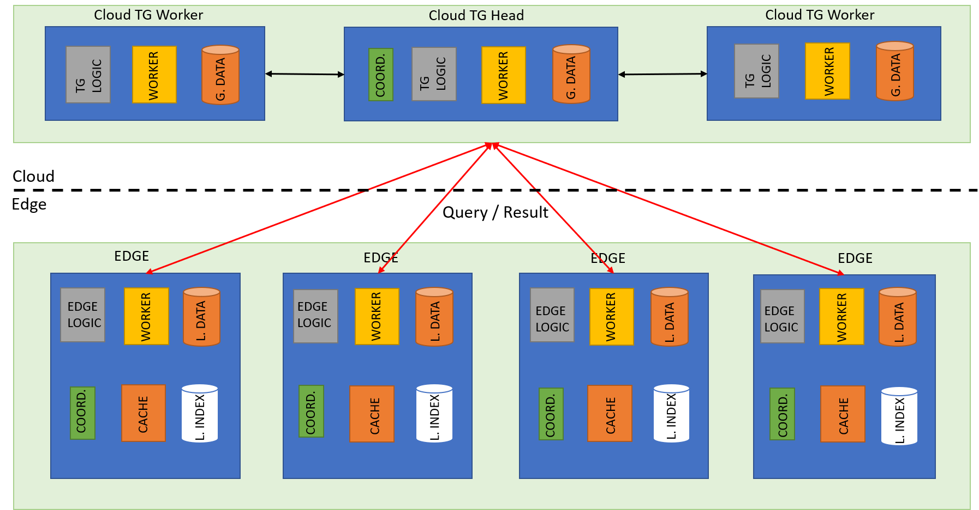
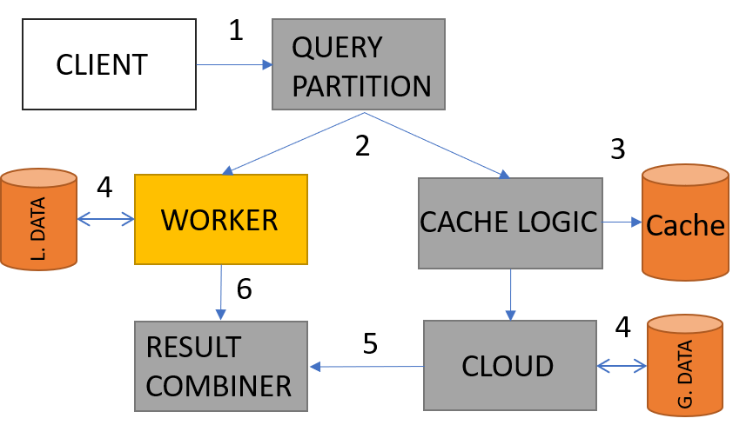
System Architecture

Slide 6
Graph Caching
Associate an entity with the edge device E.g. <India>
Store the k-hop subgraph around the entity as local graph
Parameter k depends on storage and compute capacity

Slide 7
Query Processing
Reachability
Type 1 - Entirely contained within edge (local graph)
Type 2 - Crosses between edge and remote (local + remote graph)
Type 3 - Entirely contained within remote (remote graph)
Steps
Local Query is fired to check for Type 1 existence
If no result in previous step, remote queries are fired with source as Cut Vertices for Type 2
Local queries are fired with source unchanged and target as Cut Vertices
Remote query is also fired with original source for Type 3

Slide 8
Query Processing
Path Query
N vertex and N-1 edge predicates
Null in query is wildcard
If path length < k (hops)
Fire local and remote query
Else
Fire only remote query
Union paths from local and remote query for the result
// Path Query Example
"type": "path_search",
"filter": {
"vertices": ["Mahatma_Gandhi", null, "Subhash_Agarwal"],
"edges": ["isCitizenOf", null]
}
}

Slide 9
Result Caching
Edge device caches query results from remote server
Cache size in terms of bytes is parameterized
Whenever a remote query is fired, cache is checked for hit
New query is inserted with key as query and value as result
FIFO Replacement policy
Local queries are not cached

Slide 10
Implementation
TinkerGraph used for both Cloud and Edge
Edge logic written in Python
GremlinPython package used for communication
GraphML format used to persist data

Slide 11
Experiments
Remote Graph database
1 node in-memory spawned TinkerGraph in Rigel Head Node
32 core AMD Opteron with 128 GB RAM
Centos 7
Edge Layer
4 core, 1GB RAM container
Ubuntu 18.04 LTS
Latency: 5ms & Bandwidth: 100 MBps
Dataset
YAGO minimal knowledge graph
14977 vertices, 18845 edges and 1400 total attributes
Local graph centred on <India> with 2 hops

Slide 12
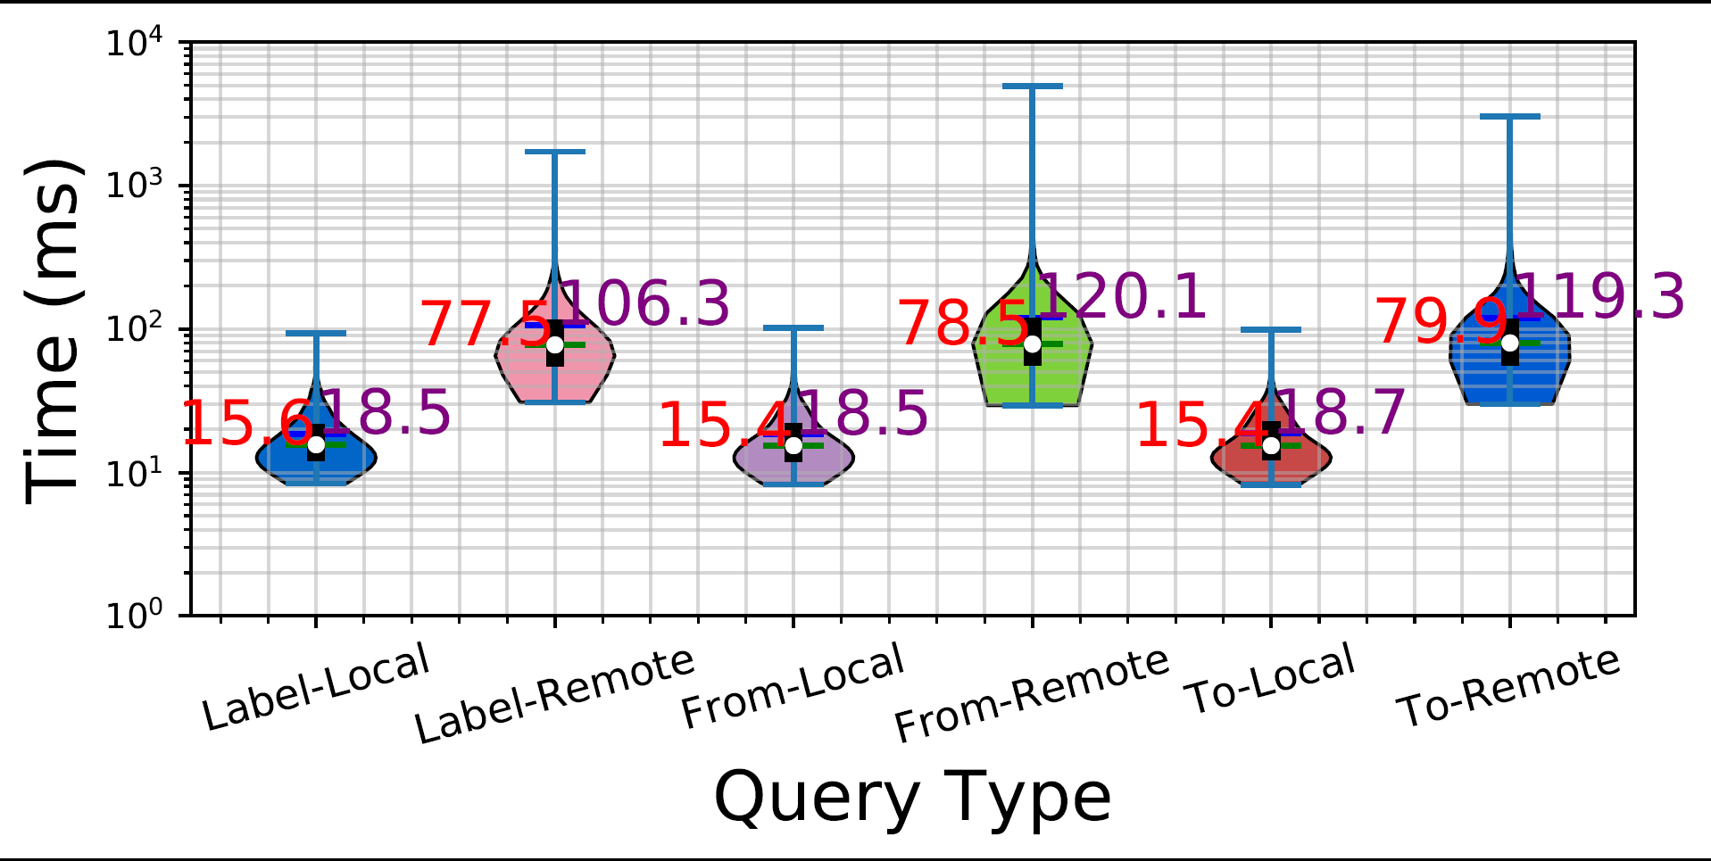
Experiments – Vertex Search

Slide 13
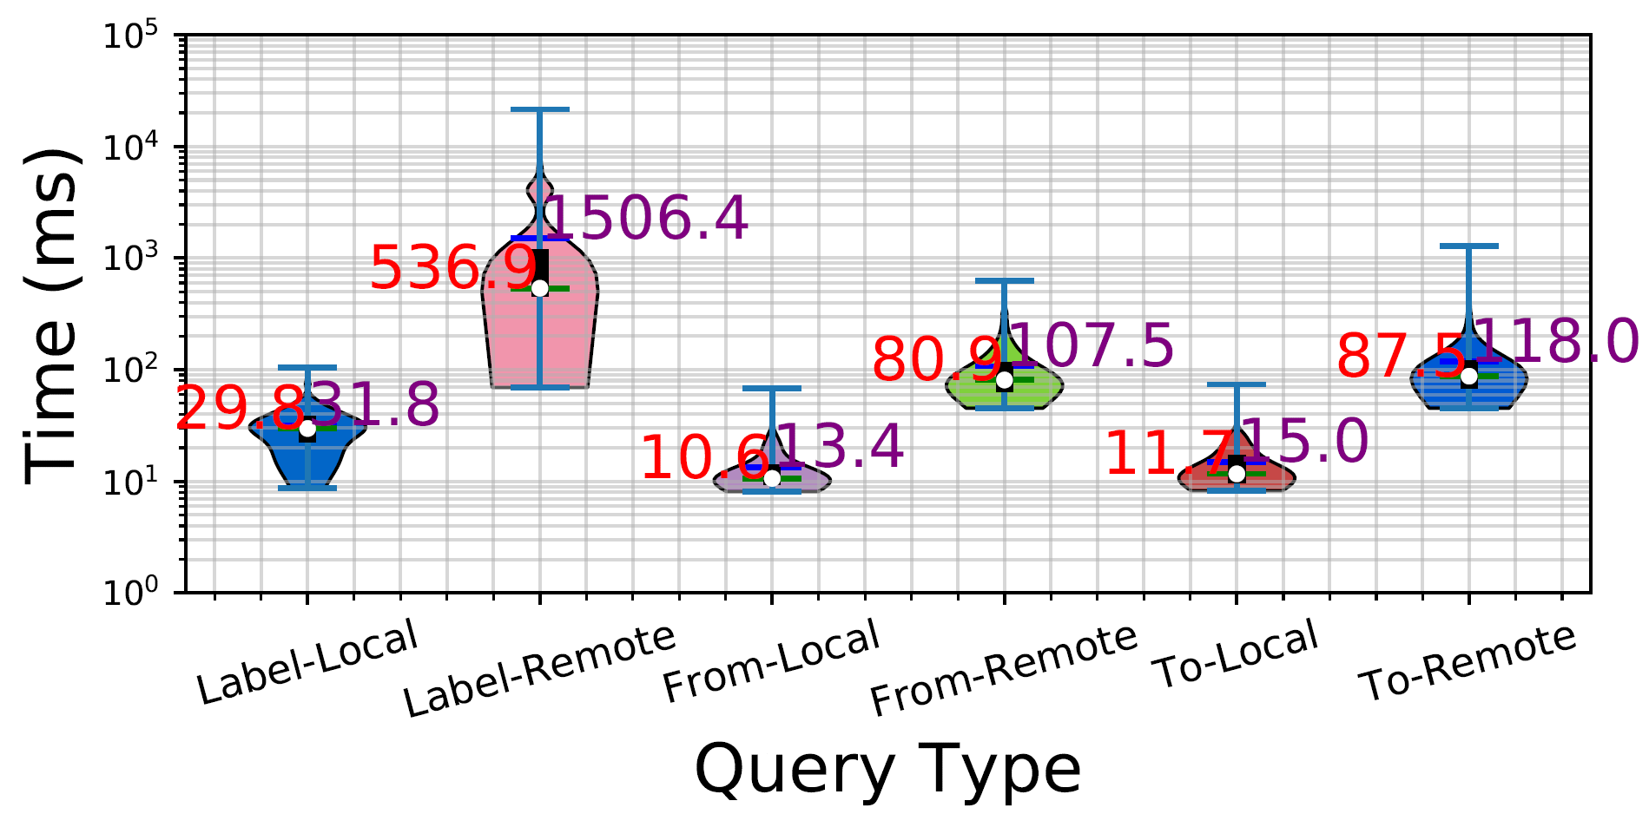
Experiments – Edge Search

Slide 14
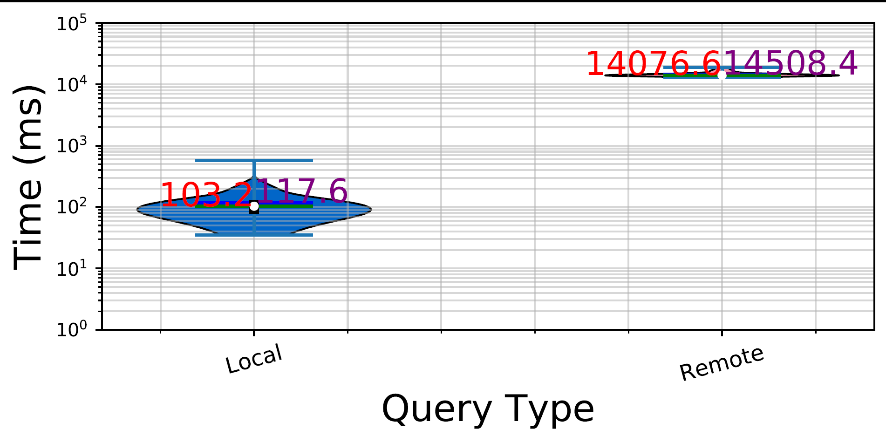
Experiments – Reachability

Slide 15
Challenges & Future Work
Challenges
Integrating GoDB with the project
Setting up distributed environment for TinkerGraph
Difficulty in setting up large cluster for experiments
ETL for the dataset
Future Work
Evaluate caching and all queries in large setup
Index the graph on the edge layer
Integrate with different datasets
Implement machine learning algorithms using this system

Slide 16
Original Proposal & Accomplishments
Midterm
Graph Caching
Query Partitioning
Combining results
Vertex, Edge search and Reachability
Experiments
Final
Caching of remote results
Support for path queries
Indexing
Experiments
Stretch Goals
Subgraph isomorphism queries
Support for Graph updates

